Slide 1

Diabetes Detection Using Machine Learning
Muhammad Osama
U41261655

Slide 2
Introduction
This data set has been taken from Kaggle. This dataset has a subset of the features from the health-related telephone survey data that is collected annually by the CDC which are considered as important risk factors for diabetes. This dataset is for the year 2015. The dataset contains answers to the questions asked in the survey. Most of the features in the dataset have Yes or No answers indicated by 1 or 0.

Slide 3
Features
Feature Name | Feature Description
HighBP | Yes or No, if a person has been diagnosed with high blood pressure
HighChol | Yes or No, if a person has ever been diagnosed with high cholesterol levels
CholCheck | Yes or No, if cholesterol check in last 5 years
BMI | Body Mass Index
Smoker | Yes or No, ever smoked at least 100 cigarettes in entire life
Stroke | Yes or No, ever had a stroke
HeartDiseaseorAttack | Yes or No, ever reported having coronary heart disease (CHD) or myocardial infarction (MI)
PhysActivity | Adults who reported doing physical activity or exercise during the past 30 days other than their regular job
Fruits | Yes or No, Consume Fruit 1 or more times per day
Veggies | Yes or No, Consume Vegetables 1 or more times per day
HvyAlcoholConsump | Yes or No, Heavy drinkers (adult men having more than 14 drinks per week and adult women having more than 7 drinks per week)
AnyHealthcare | Yes or No, if a person has any kind of health care coverage, including health insurance, prepaid plans

Slide 4
Features
Feature Name | Feature Description
NoDocbcCost | Yes or No, Was there a time in the past 12 months when you needed to see a doctor but could not because of cost
GenHlth | 1, 2,3 means good or better health. 4 or 5 means fair or poor health.
MentHlth | For how many days during the past 30 days was your mental health not good?
PhysHlth | For how many days during the past 30 days was your physical health not good?
DiffWalk | Do you have serious difficulty walking or climbing stairs?
Sex | Gender of person
Age | Age of the person (different numbers used to show age range)
Education | Level; of education (different numbers used to show if in high school, etc.)
Income | Annual Household Income
Diabetes_binary | Yes or No, Ever been diagnosed with diabetes.

Slide 5
Dataset Description
No null values found in the data set.
Dimensions of the dataset: (253680, 22)
Number of people in Diabetes Class: 35346
Number of people in Non-Diabetes Class: 218334
Random sample of 5000 rows each from the two classes, meaning a total of 10000 rows.
Supervised Learning.

Slide 6
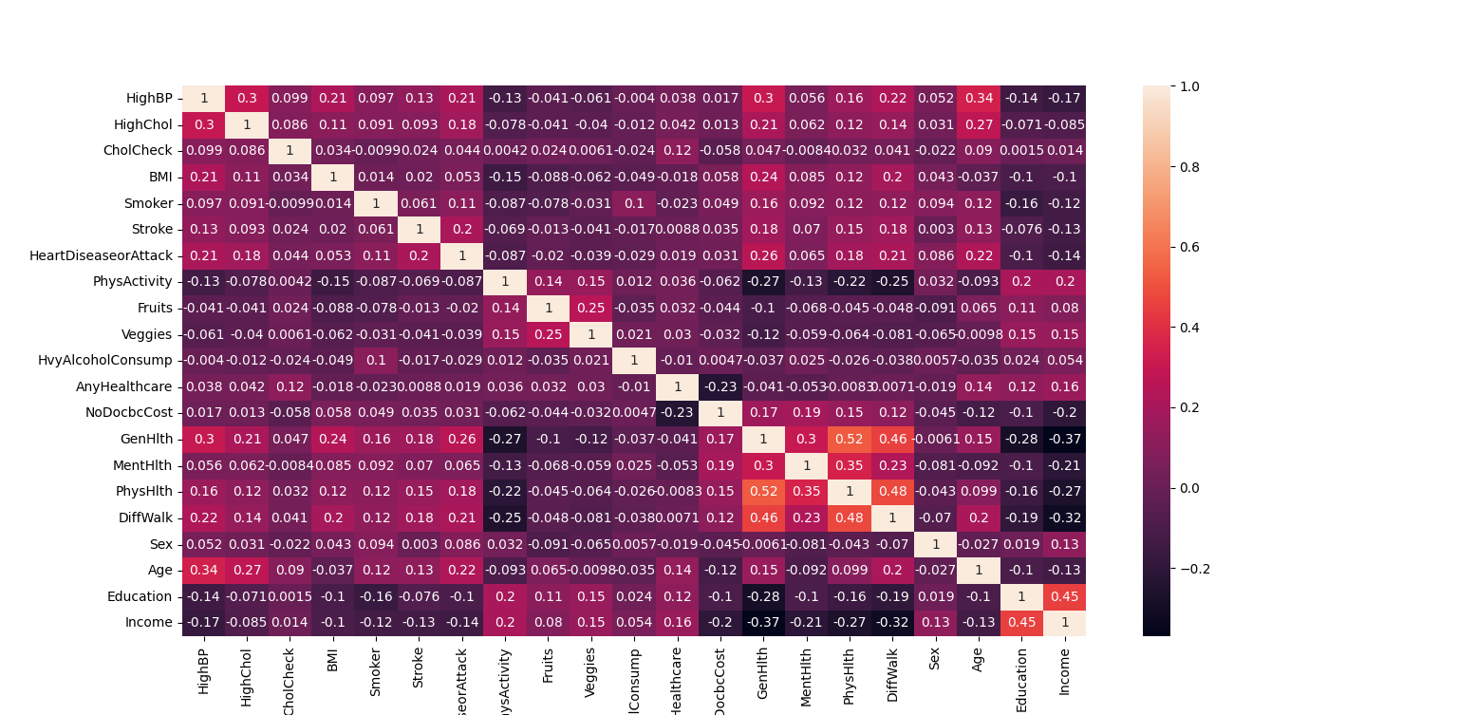
Pearson Correlation Plot

Slide 7
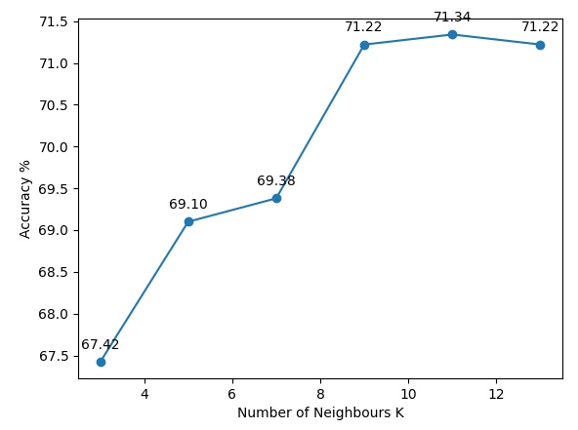
K Nearest Neighbor P = 1

Slide 8
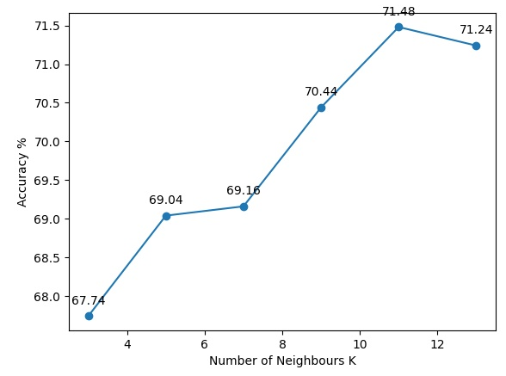
K Nearest Neighbor P = 1.5

Slide 9
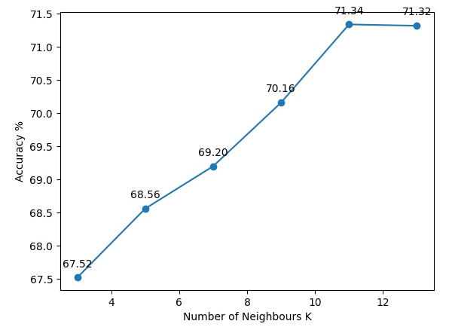
K Nearest Neighbor P = 2

Slide 10
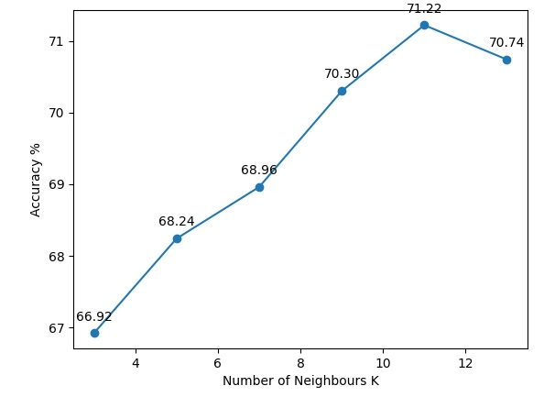
K Nearest Neighbor P = 3

Slide 11
K Nearest Neighbor Conclusion
For all values of P, the highest accuracy is for 11 neighbors.
The max accuracy for all values of P is almost the same, the highest being 71.48% for P = 1.5
Would prefer P = 1 as not much computation required and can be easily run for large datasets such as this.

Slide 12
Logistic Regression
Accuracy for Logistic Regression with all features: 74.22%
Weights for the features are as follows:
Feature Name | Weight | Feature Name | Weight | Feature Name | Weight
HighBP | 0.85668608 | PhysActivity | 0.07846623 | MentHlth | -0.15072095
HighChol | 0.62942776 | Fruits | -0.13423889 | PhysHlth | -0.25841351
CholCheck | 1.26243219 | Veggies | -0.13935377 | DiffWalk | -0.08787142
BMI | 5.40626823 | HvyAlcoholConsump | -0.64823837 | Sex | 0.13613309
Smoker | -0.04415837 | AnyHealthcare | 0.25729719 | Age | 1.61390534
Stroke | 0.07920962 | NoDocbcCost | 0.23874808 | Education | -0.47340977
HeartDiseaseorAttack | 0.24708055 | GenHlth | 2.54029155 | Income | -0.23468117

Slide 13
Logistic Regression
Removing features with negative weights and checking accuracy. Number of features removed are 9.
Accuracy for Logistic Regression without features with negative weights: 74.36%
Accuracy slightly increased and we have also significantly reduced the size of the data set.
Feature Name | Weight | Feature Name | Weight | Feature Name | Weight
HighBP | 0.78964572 | PhysActivity | 0.05887075 | MentHlth
HighChol | 0.58008288 | Fruits |  | PhysHlth
CholCheck | 1.0561844 | Veggies |  | DiffWalk
BMI | 5.89740956 | HvyAlcoholConsump |  | Sex | 0.15586659
Smoker |  | AnyHealthcare | 0.05962112 | Age | 1.5132662
Stroke | 0.14197646 | NoDocbcCost | 0.03727246 | Education
HeartDiseaseorAttack | 0.39350825 | GenHlth | 2.44785979 | Income

Slide 14
Naïve Bayesian - Gaussian
Accuracy for Naive Bayesian: 71.90%

Slide 15
Linear Discriminant
Accuracy for Linear Discriminant: 75.0%
Weights for the features are as follows:
Feature Name | Weight | Feature Name | Weight | Feature Name | Weight
HighBP | 0.86345273 | PhysActivity | 0.05923623 | MentHlth | -0.01639663
HighChol | 0.59304363 | Fruits | -0.05458343 | PhysHlth | -0.30914761
CholCheck | 0.75594544 | Veggies | -0.17954158 | DiffWalk | -0.0608103
BMI | 6.96269783 | HvyAlcoholConsump | -0.60084862 | Sex | 0.17021504
Smoker | -0.03948506 | AnyHealthcare | 0.29443414 | Age | 1.7600519
Stroke | 0.17766079 | NoDocbcCost | 0.13171834 | Education | -0.22667397
HeartDiseaseorAttack | 0.27907794 | GenHlth | 2.55747984 | Income | -0.18176663

Slide 16
Linear Discriminant
Removing features with negative weights and checking accuracy. Number of features removed are 9.
Accuracy for Linear Discriminant without features with negative weights: 74.36%
Accuracy slightly increased and we have also significantly reduced the size of the data set.
Feature Name | Weight | Feature Name | Weight | Feature Name | Weight
HighBP | 0.78964572 | PhysActivity | 0.05887075 | MentHlth
HighChol | 0.58008288 | Fruits |  | PhysHlth
CholCheck | 1.0561844 | Veggies |  | DiffWalk
BMI | 5.89740956 | HvyAlcoholConsump |  | Sex | 0.15586659
Smoker |  | AnyHealthcare | 0.05962112 | Age | 1.5132662
Stroke | 0.14197646 | NoDocbcCost | 0.03727246 | Education
HeartDiseaseorAttack | 0.39350825 | GenHlth | 2.44785979 | Income

Slide 17
Quadratic Discriminant
Accuracy for Quadratic Discriminant: 70.72%

Slide 18
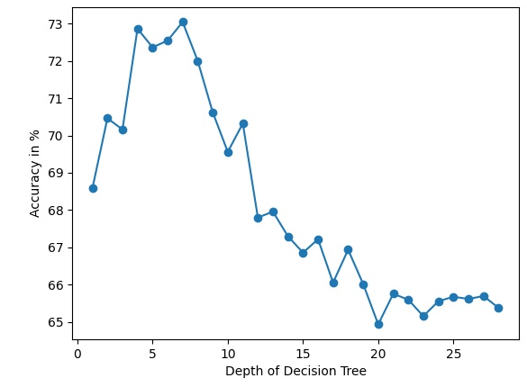
Decision Tree
Max accuracy for Decision Tree is: 73.04% for depth: 7

Slide 19
Decision Tree
The feature importance are as follows:
Feature Name | Importance | Feature Name | Importance | Feature Name | Importance
HighBP | 18.67897192 | PhysActivity | 0.49800583 | MentHlth | 2.54409196
HighChol | 5.42536772 | Fruits | 0.77067695 | PhysHlth | 2.39353647
CholCheck | 0.53544433 | Veggies | 0.65808931 | DiffWalk | 0.71277698
BMI | 13.68247227 | HvyAlcoholConsump | 0.38523137 | Sex | 0.22795587
Smoker | 0.35521333 | AnyHealthcare | 0.22753388 | Age | 8.34774112
Stroke | 0.2630675 | NoDocbcCost | 0.38255329 | Education | 2.56276888
HeartDiseaseorAttack | 0.97767836 | GenHlth | 38.44944428 | Income | 1.92137837

Slide 20
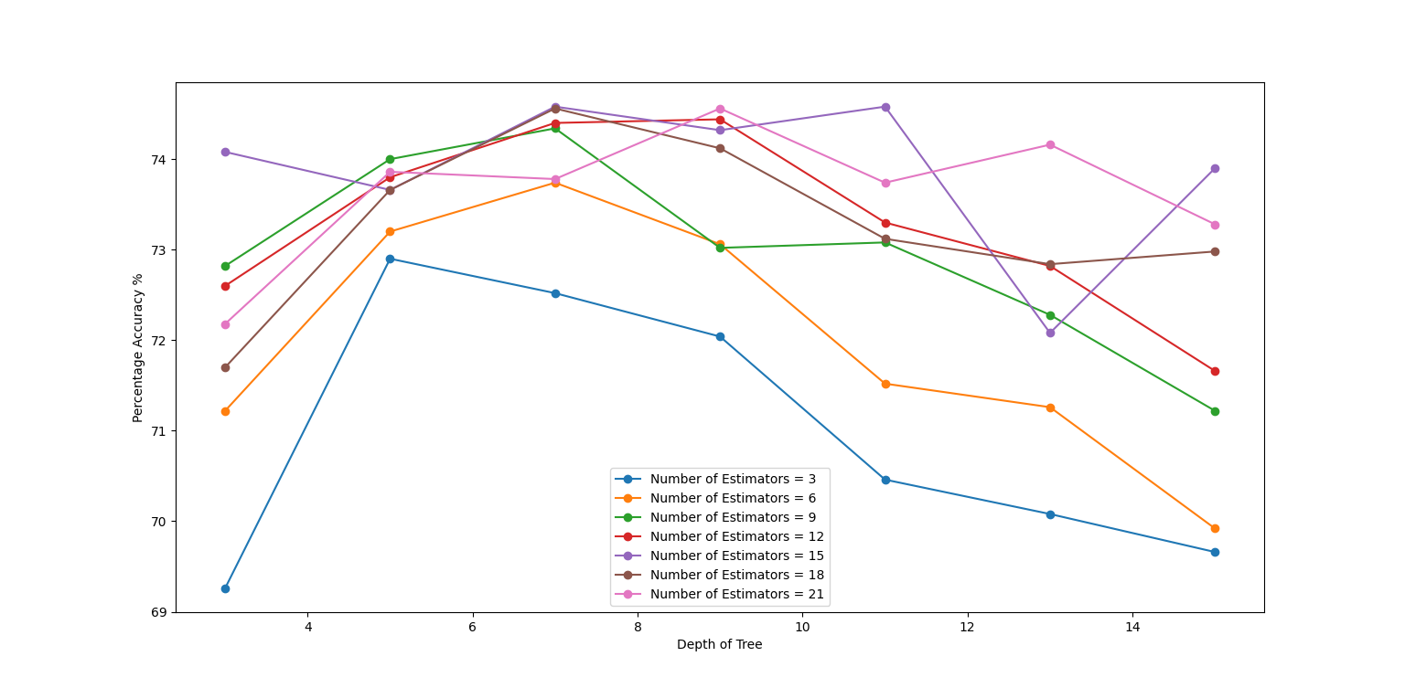
Random Forest
Max Accuracy for Random Forest is: 74.58% for 15 estimators and depth: 7

Slide 21
Random Forest
The feature importance are as follows:
Feature Name | Importance | Feature Name | Importance | Feature Name | Importance
HighBP | 20.08 | PhysActivity | 1.92 | MentHlth | 1.98
HighChol | 7.62 | Fruits | 0.83 | PhysHlth | 3.85
CholCheck | 0.52 | Veggies | 0.70 | DiffWalk | 4.11
BMI | 16.14 | HvyAlcoholConsump | 0.92 | Sex | 0.70
Smoker | 0.80 | AnyHealthcare | 0.20 | Age | 11.28
Stroke | 0.93 | NoDocbcCost | 0.54 | Education | 2.33
HeartDiseaseorAttack | 2.60 | GenHlth | 16.67 | Income | 5.27

Slide 22
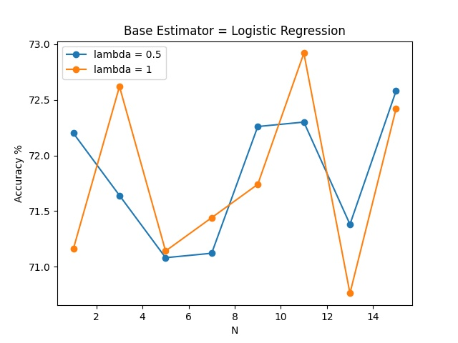
Adaboost – Logistic Regression
Highest Accuracy for Adaboost with Logistic Regression is: 72.92% with Learning rate: 1 & 11 base estimators.

Slide 23
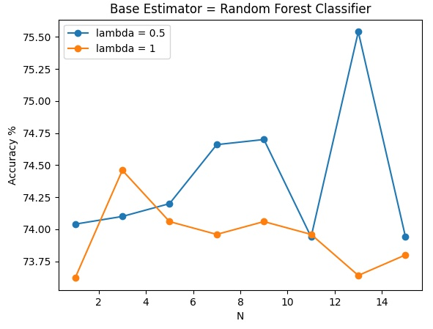
Adaboost – Random Forest
Highest Accuracy for Adaboost with Random Forest is: 75.54% with Learning rate: 0.5 & 13 base estimators.

Slide 24
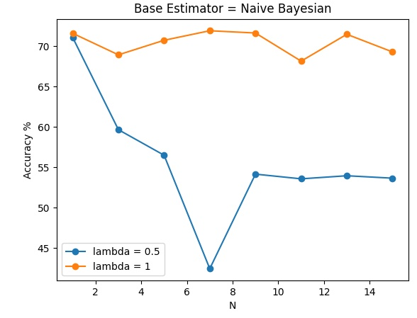
Adaboost – Naïve Bayesian
Highest Accuracy for Adaboost with Naive Bayesian is: 71.90% with Learning rate: 1 & 7 base estimators.

Slide 25
Support Vector Machine
Accuracy for Linear SVM is: 74.83999999999999%
Accuracy for Gaussian SVM is: 73.88%
Accuracy for Polynomial SVM of degree 2 is: 73.88%
Accuracy for Polynomial SVM of degree 3 is: 73.88%
Accuracy for Polynomial SVM of degree 4 is: 73.88%
Accuracy for Polynomial SVM of degree 5 is: 73.88%

Slide 26
Results
Machine Learning Classifier | Accuracy % | Machine Learning Classifier | Accuracy %
KNN with P = 1 | 71.34% | Adaboost with Naïve Bayesian | 71.90%
KNN with P = 1.5 | 71.48% | Linear SVM | 74.84%
KNN with P = 2 | 71.34% | Gaussian SVM | 73.88%
KNN with P = 3 | 71.22% | Polynomial SVM Degree 2 | 73.88%
Logistic Regression | 74.36% | Polynomial SVM Degree 3 | 73.88%
Naïve Bayesian | 71.90% | Polynomial SVM Degree 4 | 73.88%
Linear Discriminant | 75.00% | Polynomial SVM Degree 5 | 73.88%
Quadratic Discriminant | 70.72%
Decision Tree | 73.04%
Random Forest | 74.58%
Adaboost with Logistic Regression | 72.92%
Adaboost with Random Forest | 75.54%

Slide 27
Conclusion
Adaboost with Random Forest has the highest accuracy of 75.54%
Quadratic Discriminant has the lowest accuracy of 70.72%
Prefer using Logistic Regression as very easy to compute and low sensitivity to changes in the data set. Accuracy is 74.36% which is very close to the maximum accuracy and, this accuracy has been calculated using the dataset with reduced features. Only 12 features of the dataset were used.

Slide 28
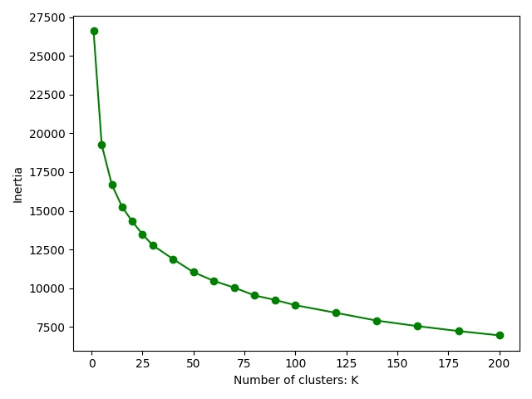
K Means Clustering
Not suitable for implementation. Entropy too high & requires too many clusters to reduce it.

